Slide 1

Business location recommender
Rafael de sant’anna chagas

Slide 2
Introduction
An application that helps entrepreneurs find the best location for their new business has been developed for this final project.

Slide 3


Data
Venues data is provided by Foursquare;
Coordinates data is provided by Nominatim.

Slide 4
Application
The application functionalities will be explained and tested;
São Paulo will be used as the business location city, and the business category will be “Theater” in this simulation.

Slide 5
Mapping region areas
Cities are mapped using a circular pattern to identify which coordinates belong to the city where the business must be located.
Accomplished with the use of Nominatim API.

Slide 6
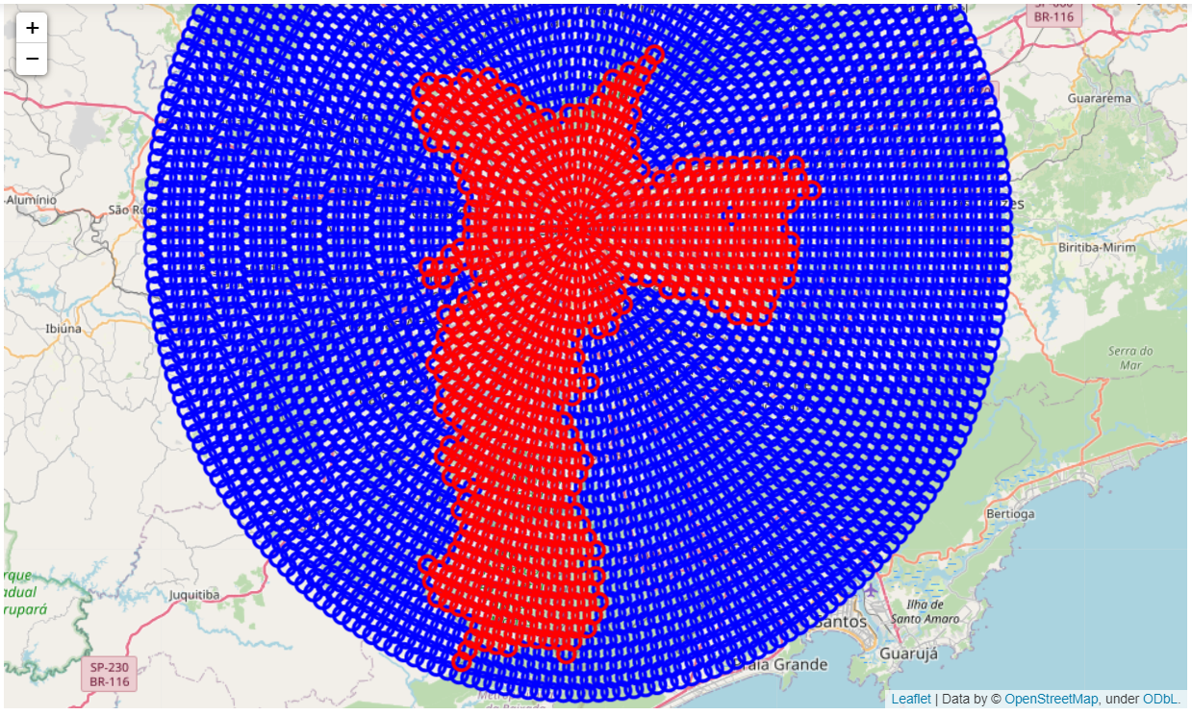
City – São paulo
The city is represented by the red circles.

Slide 7
fetching city venues
The application fetches the most important venues for each area.
Then, it deals with the duplicated venues fetched due to the necessary overlapping areas.

Slide 8
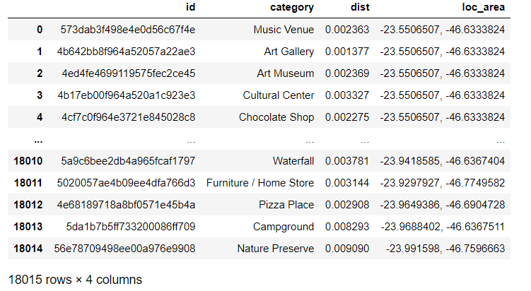
venues

Slide 9
Locations’ patterns vectors
Each location is analyzed according to its venues’ categories’ count.
Then, these counts are used to create locations’ vectors.
These vectors contain the number of venues pertaining to each category.

Slide 10
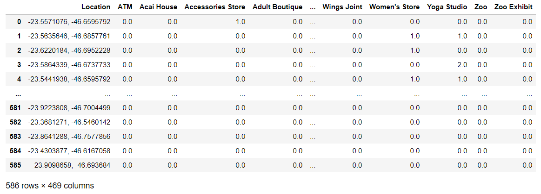
Locations’ patterns vectors

Slide 11
Grouping city areas into clusters
All areas are grouped into different clusters;
Based on theirs locations’ patterns vectors.

Slide 12
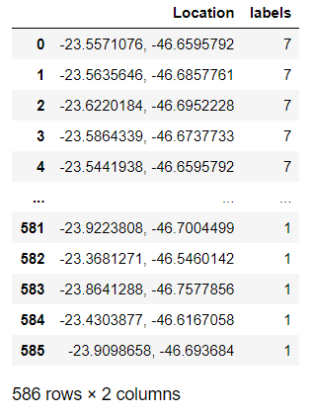
clusters

Slide 13
Identifying the best locations
The application identifies the cluster where the chosen business category fits the best, meaning that this business category will likely thrive in areas with this cluster’s pattern.
Then, it chooses the areas within this cluster where the business has the highest chances of success.

Slide 14
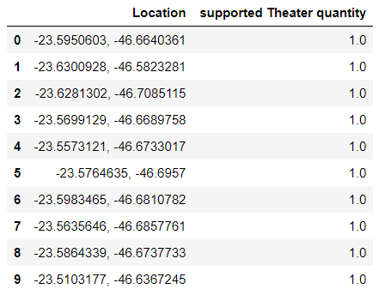
best locations

Slide 15
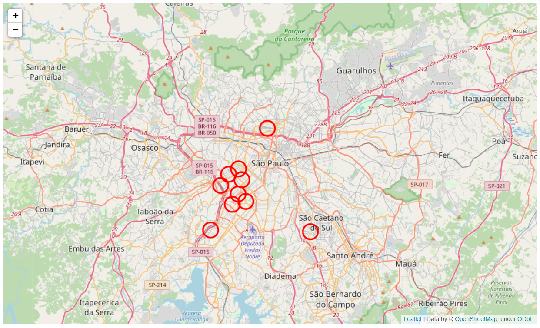
Results
These are the best locations to open a Theater.

Slide 16
Conclusion
This type of data analysis can provide every entrepreneur the necessary support, so they can choose the right spot for their business.
It gives them an opportunity to move forward, reducing the risk of failure.

